Slide 1



2nd NQF Forum
Luanda, Angola
6th September 2024

Slide 2


Context
In parallel to the technical development of the Qualifications and Credentials Platform (QCP), we will conduct a training programme for stakeholders involved in managing and using qualifications databases
Means
Training activities (such as during this meeting)
Training material for self-paced learning
Aim
Addressing foundational knowledge and providing hands-on support to ensure successful adaptation and usage of the QCP
Several major themes identified until the end of 2024
Notes:
Welcome, everyone, to this training session on the Qualifications and Credentials Platform (QCP). Our aim today is to address foundational knowledge and provide hands-on support to ensure successful adaptation and usage of the QCP. This training is part of a series of activities identified until the end of 2024, including self-paced learning materials that will be shared in the coming months.
More detailed information on formats, dates and opportunities, as well as the provision of the training material for self-paced learning will be shared with everyone throughout the next months, as we continue the development of the QCP and identify relevant meetings and milestones.

Slide 3






Major themes
Technical Aspects
Using the QCP, navigating UI, accessing/querying databases
Data entry, validation, and management
Interoperability Concepts
Standards and protocols (e.g., Linked Data, ISCED) for data exchange
Data Governance and Security
Data governance principles, ownership, privacy, security
Compliance with data protection regulations
Quality Assurance and Validation
Processes for validating and verifying qualifications data
Capacity Development
Building capacity for managing/updating national databases
Aligning national data with international standards.
Policy and Strategic Alignment
Policy frameworks and strategic initiatives in the African context
Notes:
The major themes we will cover throughout the 2024 training activities include:
Technical Aspects: Using the QCP, navigating the UI, accessing/querying databases, and managing data.
Interoperability Concepts: Standards and protocols like Linked Data and ISCED for data exchange.
Data Governance and Security: Principles of data governance, ownership, privacy, and compliance with data protection regulations.
Quality Assurance and Validation: Processes for validating and verifying qualifications data.
Capacity Development: Building capacity for managing and updating national databases and aligning data with international standards.
Policy and Strategic Alignment: Understanding policy frameworks and strategic initiatives in the African context.

Slide 4
Qualifications and Credentials Platform (QCP) – Training on QCP concepts and tools
Objective of today’s training
Understand the ACQF Qualifications Database and set up Organisational Structure to work with it.
Notes:
Today’s training aims to help you understand qualifications databases and their implementation within the context of ACQF and the Qualifications and Credentials Platform (QCP) we are currently developing.
We will explore the purposes and users of qualification databases, their role in the international context, and key concepts such as data standards and interoperability

Slide 5
Agenda
01
Demonstration of Citizen Facing Functionalities of ACQF DB
Introduction to Organisational Processes for Data Management
03
Demonstration of Qualifications Curator Functionalities of ACQF DB
Data Collection
Plans
02
04
Notes:
Our agenda today includes:
Understanding the purpose and users of qualification databases.
Exploring the role of qualification databases in the international context.
Mapping and standardizing qualifications data.
Integrating learning outcomes into qualifications databases.
Understanding structured data and data standards.
Introducing the ACQF data model.

Slide 6

Demo
Demo of the ACQF Database (Citizen View)

Slide 7
Locate Data
Find all Qualifications Data in your National Jurisdiction.
05
Publish
Do a final check, and release the data to the public via the ACQF Qualifications Platform
01
04
Upload
Introduce your data to the ACQF Qualifications Platform
Set up Transformations
Create processes to convert your national data into the ACQF Data Format.
02
03
Quality Assure
Check data for clarity, correctness and completeness.
Notes:
Locate Data
Set up Transformation Rules
Upload Data
Quality Assure Data
Publish

Slide 8

Locate Data
Purpose
Do you already have a single source of data for all qualifications?
Do you have several databases which are divided:
  regionally?
  by sector of education?
  formal vs non-formal education?
Organisation
Single data supplier
Administrator with multiple data suppliers
Ensure coverage
of entire NQF
Notes:
Qualification databases serve as a central repository for storing and managing qualification information.
They facilitate recognition and comparison of qualifications and support educational and workforce planning.
Key functions include storing qualifications data, providing access to reliable information, and enabling data analysis for policy making.

Slide 9
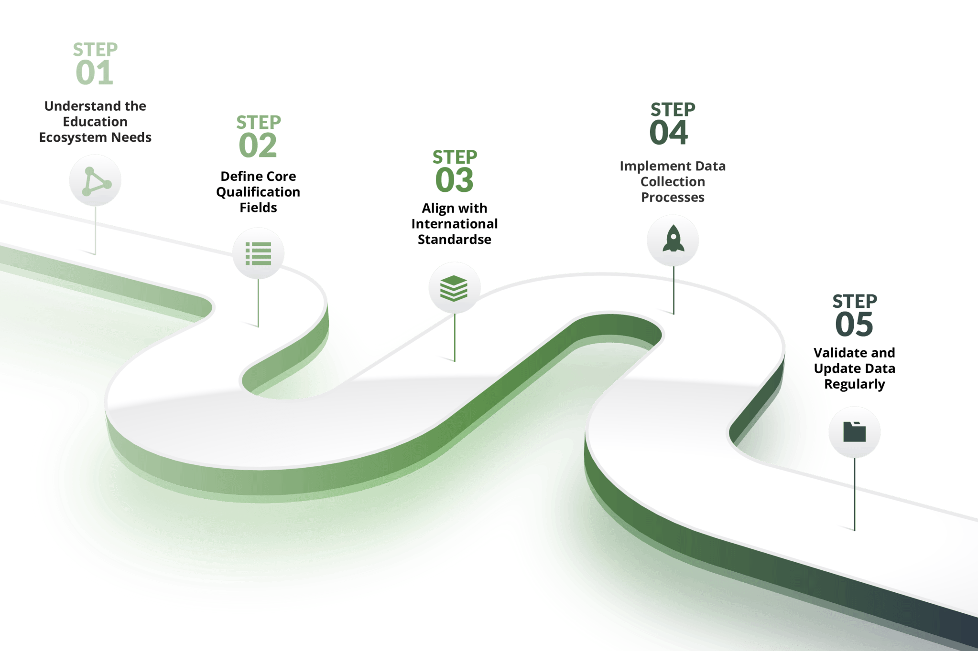
Pre-Requisite: Mapped and Standardised Qualifications Data
Transform Data
Notes:
In summary, these 5 steps are essential to map and standardise your qualifications data. Depending on your current status-quo, you might already have completed some of the steps. In this case, we recommend looking to refine the processes and to focus on the steps that are still outstanding.

Slide 10
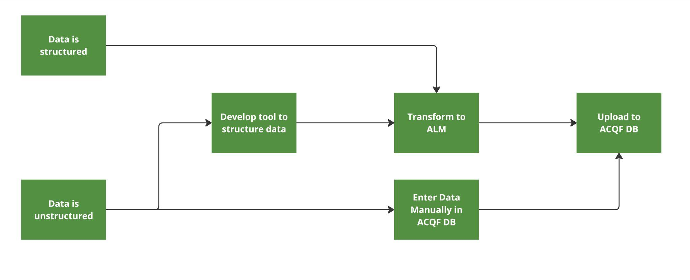
Transform Data

Slide 11



Tools to Structure Data
Stop using Unstructured
Stop saving structured data as unstructured
Use PDFs as ‘auditing’ evidence not as data retrieval source
Most efficient and cost-effective option
Template Based Extraction
Useful if data is structured in forms that always have same headings
Automated tool to extract data from those forms, turn into searchable text, and save into a database
High Degree of reliability
Semantic Based Extraction
Useful if Qualifications Data forms tend to be different
AI and other tools used to extract meaning and populate database
Quite experimental and not fully reliable.
Notes:
Qualification databases serve as a central repository for storing and managing qualification information.
They facilitate recognition and comparison of qualifications and support educational and workforce planning.
Key functions include storing qualifications data, providing access to reliable information, and enabling data analysis for policy making.

Slide 12
Mapping and Standardising Qualifications Data
Example
Field Name | Description | Example
Qualification Title | The official name of the qualification | Bachelor's Degree in Engineering
Qualification Level | The level of the qualification | QF Level 6
Field of Study | The specific area or discipline of the qualification | Mechanical Engineering
Awarding Body | Institution that issues the qualification | University of Nairobi
Date of Award | The date when the qualification was awarded | June 2020
Learning Outcomes | Skills and competencies gained | Ability to design mechanical systems
Duration | The time taken to complete the qualification | 4 years
Credits | The credit value of the qualification | 240 ECTS
Mode of Study | The mode in which the qualification was delivered | Full-time, Part-time, Online
Others | Any other relevant information | Accreditation details, Language of instruction

Slide 13
Overview of data properties
Class | Property | Expected value
Qualification | awarding information | Awarding Opportunity
 | education level | ACQF levels
 | learning outcome | Learning Outcome
 | publisher | Organisation
 | thematic area | ISCED-F
 | title | String with language
Awarding Opportunity | awarding body or note | Organisation or Note
Learning Opportunity | default language | Language
 | provided by | Organisation
 | qualification | Qualification
 | title | String with language
Learning Outcome | title | String with language
 | related skill or note | Skill or Note
Location | spatial code | Location code
Organisation | location | Location
 | name | String with language

Slide 14
Quality Assure Data (Clean Data)
Before Publication, all qualifications must be quality assured.
On Preparation
On Transformation
On Upload / Before Publication
When a Qualification is approved nationally, administrative and legislative checks are undertaken.
Checks that the mapping has been done correctly, and that the technical tools output their
Check that errors have not been introduced by the interface, check completeness, check for corruption
1
2
3

Slide 15
Typical Effort Distribution of a Data Science Project
20%
Locating & Entering Data
60%
Cleaning/QA of Data
20%
Extracting Insights

Slide 16
The ‘’7 sins of data quality’’
01
The Description Dumper
The Learning Outcome Avoider
The Data Model Hacker
The Know it All
05
The Dummy Data Provider
The Worshiper of old Gods
The Minimalist
02
06
03
07
04

Slide 17



The Description Dumper
The description dumper just copies all properties to the description field, and doesn't map their data to the properties.
Instead of rich data we can process, we receive a paragraph of text that is far less useful.

Slide 18




The Learning Outcome avoider
No learning outcomes in data at all
All learning outcomes jumbled into one textbox
Learning outcomes not linked to ESCO or other frameworks

Slide 19



The Data Model Hacker
Use of custom properties to avoid matching to data model
Using properties for purposes which they are not intended

Slide 20



The know it all
Does not quality assure data before posting
Assumes data is correct without any basis

Slide 21



The Dummy Data Provider
Using Dummy data to fill required fields
Forgetting to remove test data from the datasets

Slide 22



The Worshiper of Old Gods
Using the old data formats
No plan to migrate to newer formats

Slide 23



The Minimalist
Populating only the required data fields
Limited information provided per data field

Slide 24

Uploading & Publishing Data
Demo Part 2: Uploading and Publishing Data in the ACQF Platform

Slide 25


Updating Data
Push
The database administrators are notified each time a modification is made to a qualification, and it is immediately updated in the ACQF
Notification can happen automatically, or via a business process
Pull
There is no automatic notification.
Database administrator locates updates, checks them for completeness and uploads
Process is done several times per year (3-12)

Slide 26
Typical QCP Roles
Qualification Author
Determine Learning Requirements
Write Qualification Documentation
Qualification Approver
Determine compliance with legislative and administrative requirements
Approve qualifications for provision
Existing Roles
New Roles Required
Qualification Curator
Collects Qualifications which have been approved
Checks documentation for compatibility with QCP
Standards and
Transforms Data to QCP formats
Manages QCP Data Upload
Qualification Administrator
Manages Access to the QCP for various
Qualification Curators

Slide 27
Updating Data
Large Updates = New Qualification
Minor Updates = Minor Update to existing Qualification
Versioning
Each National Authority needs to determine the versioning policy for themselves
The ACQF DB merely implements the versioning policy requested

Slide 28

Data Collection Activity
Build a Unified Database:
Integrate qualifications data across African countries, while ensuring data standardisation, integrity and validation
Coordination with national partners
Understand data state(s) and planned approaches of data insertion
Gathering and standardising qualifications data
Quality assurance and support
Data upload

Slide 29
Data Collection Activity Timeline
2024
Preparatory steps
Workshop
Data collection protocol
Framework set-up, communication with stakeholders
Quality assurance system
2025
Ongoing (bilateral) support
Ongoing data collection, initial upload (Q1)
Monitoring of KPIs: Data collection reports (Q1)
Data validation (Q2)

Slide 30


Data Collection Activity: Immediate steps
Nomination of Single Point of Contact (SPOC): main liaison person between project team and national organisation for the data collection activity.
Expertise in data management: data entry, validation, maintenance of data
Knowledge of qualifications and NQF
Online workshop with SPOCs:
Understand data state
Guidance
Planned approach of data insertion
Effort planned to dedicate
Set objectives of data inserted by summer 2025
Further information on the ACQF data model: https://data.acqf-qcp.africa/

Slide 31



Conclusion and Next Steps
Software development next steps
First-phase qualification curation portal to be delivered by the end of 2024
Dissemination and testing of the curation portal start from early 2025
Training
Peer-Learning event to be held online in Q4 2024
Training Package to be published to ACQF website
Data Collection
Nominations of SPOCs and establishment of communication
Workshop in Q3 2024

Slide 32

Thank you
Obrigado
Merci

